Slide 1
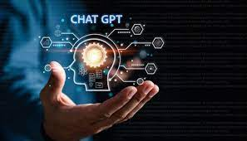
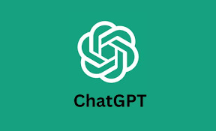
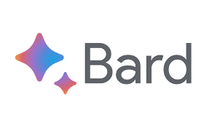

CHAT GPT AND ITS APPLICATIONS

Slide 2
INTRODUCTION
ChatGPT is an advanced language model developed by OpenAI that leverages the power of artificial intelligence (AI) to generate human-like responses to questions or prompts.
ChatGPT has taken the Internet by storm since it came out in November 2022 with its ability to generate well-written content in a variety of fields and topics.
A chatbot, short for "chat robot," is a computer program or an AI application that simulates human-like conversations with users through text-based or voice-based interactions.
Automated chatbots are computer programs powered by artificial intelligence that simulate human-like conversations with users. They are designed to interpret and respond to text or voice-based queries and perform specific tasks autonomously. Chatbots can be integrated into websites, messaging applications, social media platforms, and various other digital channels, allowing businesses to engage with customers in real-time and provide instant assistance.

Slide 3
CONTENT CREATION
Content creation is the process of generating topic ideas that appeal to your buyer persona, creating written or visual content around those ideas, and making that information accessible to your audience as a blog, video, infographic, or other content formats

Slide 4
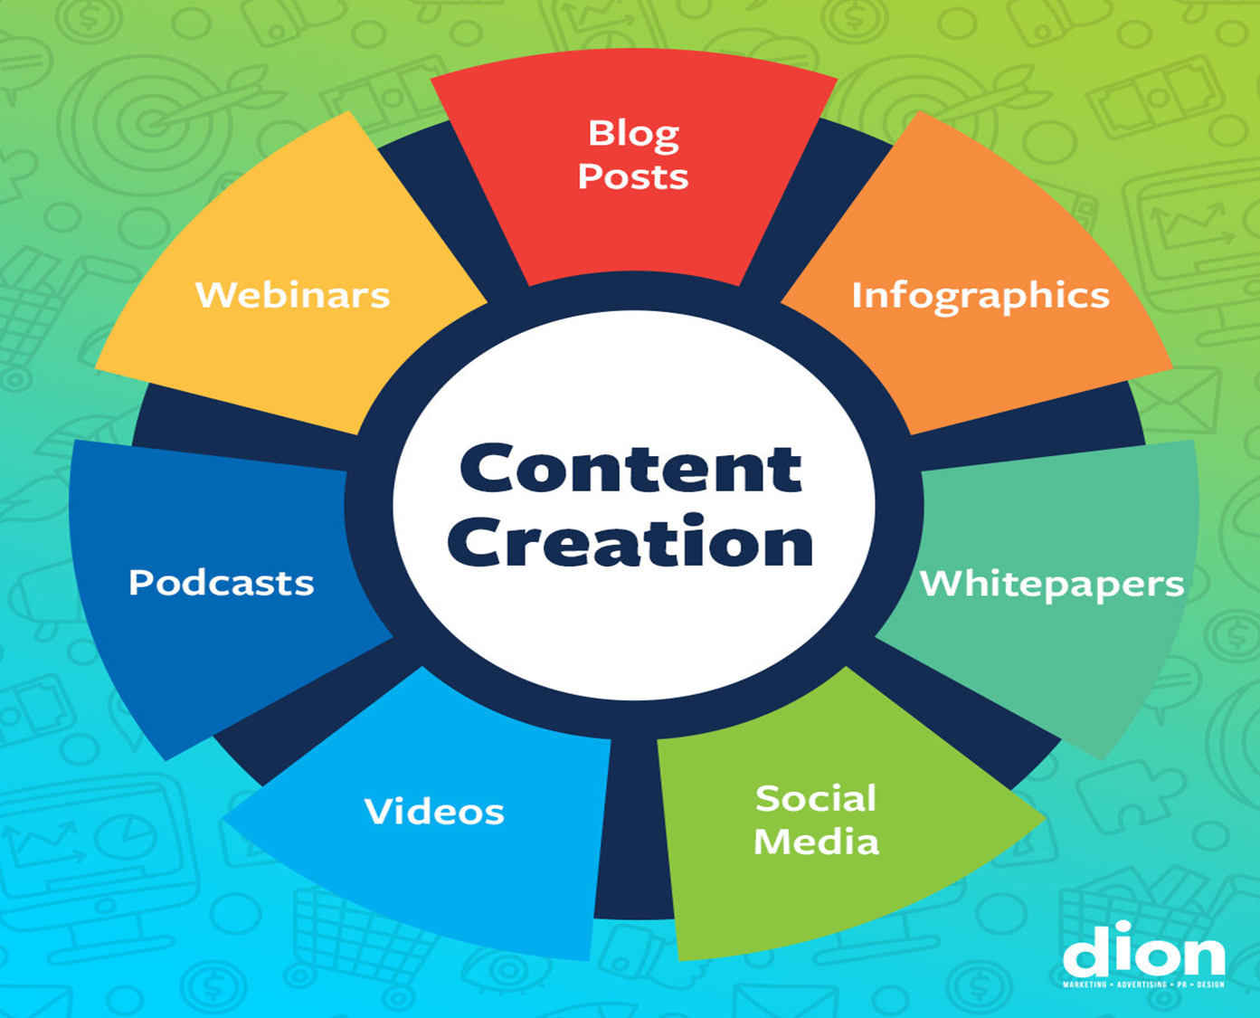
Content Creation with ChatGPT
Creating engaging, high-quality content is essential for successful content marketing, and ChatGPT offers innovative solutions to help achieve this goal.
It has become a game-changer in this regard by offering unique solutions to create various types of content.

Slide 5
steps on how to create content using ChatGPT
Go to the ChatGPT website: https://chat.openai.com/ and create an account.
Once you have an account, you can start inputting prompts to generate content. For example, to create an "About Us" page, you can input the prompt "Write an 'About Us' page for a software company."
ChatGPT will generate text based on your prompt. You can then edit the text as needed.
You can also use ChatGPT to generate outlines, sub headers, and other content elements.

Slide 6
TIPS
Be clear and specific in your prompts. The more specific you are, the better ChatGPT will be able to understand what you want.
Use keywords and phrases that are relevant to your topic. This will help ChatGPT to generate more relevant content.
Edit the text as needed. Chat GPT's output is not perfect, so you will need to edit it to make sure it is accurate and grammatically correct.
Use ChatGPT as a tool, not a replacement for your own writing skills. ChatGPT can help you to generate ideas and content, but it is still important to be able to write well yourself.

Slide 7
EXAMPLES
Blog posts- Marketers can enter keywords and specific requirements into ChatGPT, and the AI model will create high-quality, original content that is SEO-friendly and engaging for the target audience.
Articles
Landing pages- a standalone web page, created specifically for a marketing or advertising campaign. It's where a visitor “lands” after they click on a link in an email, or ads from Google, Bing, YouTube, Facebook, Instagram, Twitter, or similar places on the web
Emails
Social media posts - ChatGPT can generate social media posts for various platforms, including Facebook, Twitter and LinkedIn. The AI technology will search its database for trending words and optimize short, quippy captions or longer, blog-style captions for the user.
Whitepapers - “It is a persuasive, authoritative, in-depth report on a specific topic that presents a problem and provides a solution. Marketers create whitepapers to educate their audience about a particular issue or explain and promote a particular methodology.
Reports
Scripts - ChatGPT can generate video scripts for marketing and promotional videos. Whether it's a commercial or a full-length feature, ChatGPT can do it.
Creative writing

Slide 8
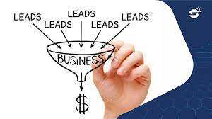
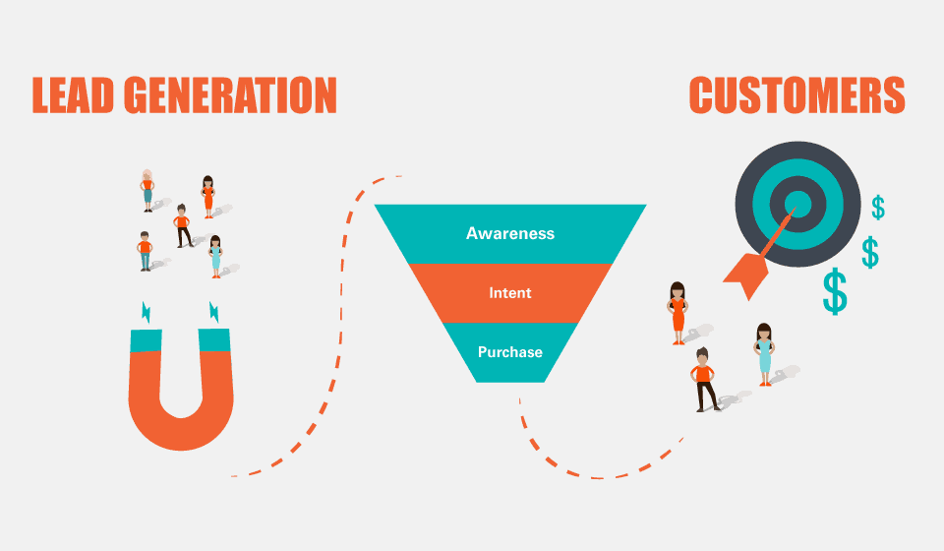
What is lead generation
Any person who has an interest in a company’s product or service is considered a lead.
Not anyone and everyone is a lead, as people have different preferences and needs.
Many businesses make the mistake of marketing to everyone when they should focus on people who are interested in what the company has to offer.
Lead generation can be defined as the process of attracting prospects and converting them into someone who has an interest in your company’s products and services.

Slide 9
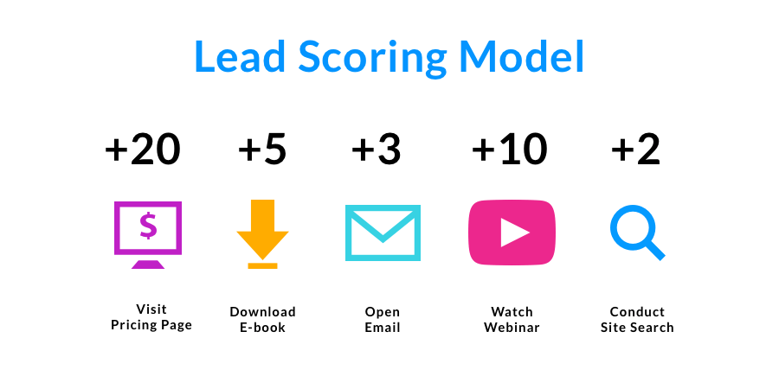
How Do You Improve Lead Quality?
Use Lead Scoring
Lead scoring allows you to rank your leads by their interest levels and readiness to buy. You assign points to leads based on their actions and behavior on your website. There is no exclusive method for scoring leads, which is why companies define their own scoring systems to suit their needs.
Points can be awarded for:
Visiting your website
Opening your mails
Clicking through to a promotion
Downloading free resources (e-book or PDF)
Watching a webinar
Started a free trial

Slide 10
B2B marketers claim that they generate leads from the following social networks:
39% of B2B marketers say they generated leads from Facebook
30% of B2B marketers say they generated leads from Twitter
44% of B2B marketers say they generated leads from Linkedin

Slide 11
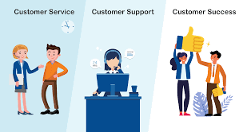
What is customer support
Customer support, also known as customer service, is the process of assisting and providing assistance to customers before, during, and after they purchase a product or service from a company.
The primary goal of customer support is to address customer inquiries, resolve issues, and ensure customer satisfaction.

Slide 12
ChatGPT is an excellent resource for providing 24/7 customer support, so your ecommerce site is available to consumers no matter their time zone or shopping needs. Train ChatGPT as a chatbot to answer FAQs, support requests and more needs like:
Automated Chatbots: ChatGPT can handle simple and routine customer service inquiries, such as order tracking, account information and product information.
Self-Service: ChatGPT can provide customers with self-service options for resolving their issues like referrals to FAQs, tutorials and videos.
Multi-Language Support: It can be difficult to find customer service agents who speak more than one or two languages, and customers from all backgrounds need assistance. ChatGPT is a customer service representative that speaks multiple languages, making it easier for companies to serve customers globally.

